Slide 1

Hotel Reservation Operations Analytics

Slide 2
Meet Team
Gopi Vishal Yadla
Background: B.Tech
Experience: Fresher
Linkedin:
https://www.linkedin.com/in/yadla-gopi-vishal-737459378
GitHub:-
https://github.com/51vishal
Ketha J Harshith
Background: B.Tech
Experience: Fresher
Linkedin:
https://www.linkedin.com/in/ketha-j-harshith-857b85265
GitHub:-
https://github.com/harshith123-26
Vipparthi Prakash
Background: B.Tech
Experience: Fresher
Linkedin:
https://www.linkedin.com/in/prakash-vipparthi-058848351
GitHub:
https://github.com/prakashvipparthi-hub

Slide 3
Table of contents
Project Overview
Business Scenario
Business Objectives
Dataset & Database Overview
ER Diagram & Database Structure
Analysis of the Objectives
Overall Key Findings
Business Recommendations
Conclusion
Q&A

Slide 4
Project Overview
This project focuses on analyzing hotel reservation operations using MySQL. The objective is to convert hotel reservation data into meaningful business insights.
The analysis covers:
Booking demand
Guest booking behaviour
Stay performance
Staff and room performance
Booking and stay problems
The project demonstrates the complete process from understanding business requirements to writing SQL queries and interpreting results.

Slide 5
Business Scenario
StayPoint Hospitality manages multiple hotels and maintains data related to guests, bookings, rooms, stays, and staff.
The company needs to analyze booking demand across hotels, booking channels, room types, and different time periods.
It also needs to understand guest booking behaviour, including booking frequency, spending, and differences between guest types.
The organization wants to evaluate stay, staff, and room performance to improve operational efficiency and resource utilization.
Finally, the company needs to identify booking and stay problems such as cancellations, no-shows, and high service requests, so that management can take appropriate action.

Slide 6
Business Objectives
Analyze booking demand to understand which hotels, booking channels, and room types receive the most bookings.
Understand guest booking behaviour by studying booking frequency, booking amounts, guest types, and booking patterns.
Evaluate stay performance by analyzing stay outcomes, duration, status, and performance across different hotels and time periods.
Measure staff and room performance to understand workload, room usage, and how effectively hotel resources are being utilized.
Identify booking and stay problems such as cancellations, no-shows, and service requests, and use the findings to support better operational decisions.

Slide 7
Dataset & Database Overview
Table / Dataset | Records | Columns | Purpose
Guests | 350 | 7 | Contains guest details and preferences
Hotels | 25 | 6 | Contains hotel details and room capacity
Rooms | 600 | 7 | Contains room details, types, occupancy, and pricing
Bookings | 2,800 | 8 | Contains guest reservation and booking details
Stays | 3,200 | 10 | Contains check-in, check-out, stay status, and service details
Staff | 70 | 6 | Contains staff details, department, rating, and active status

Slide 8
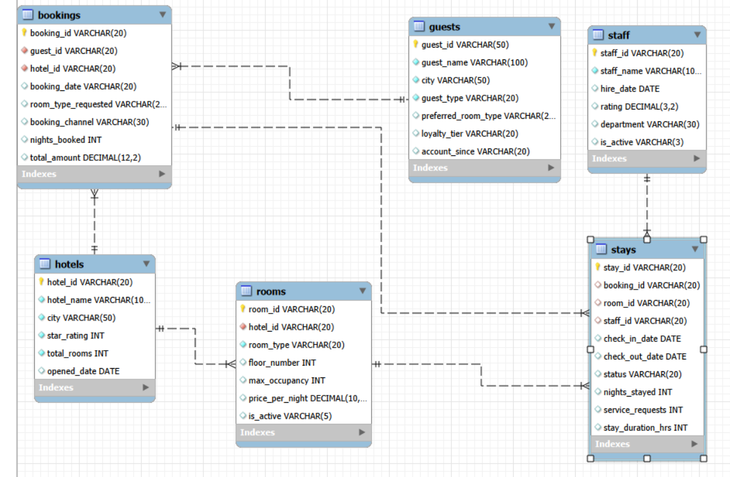
ER Diagram & Database Structure

Slide 9
Analysis of the Objectives
Objective | Analysis Performed
Booking Demand | Analyzed bookings across hotels, booking channels, room types, time periods, and booking amounts to understand booking demand.
Guest Booking Behaviour | Analyzed guest booking frequency, total booking amount, activity across hotels, guest types, and booking patterns over time.
Stay Performance | Compared stay outcomes across hotels, examined stay duration, analyzed different stay statuses, and evaluated stay performance over time.
Staff & Room Performance | Analyzed the number of stays handled by staff, staff performance, stay duration, room usage by room type, and stay performance across rooms.
Booking & Stay Problems | Analyzed cancellations, no-shows, stay status patterns, service requests, and hotels with higher booking or stay problems.

Slide 10
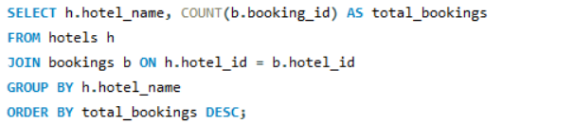
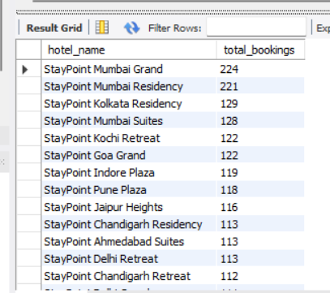
Which hotels have the highest number of bookings?
Key Insights:
This query identifies the hotels with the highest number of bookings and ranks them from most to least booked. It helps understand which hotels are most popular among customers.

Slide 11
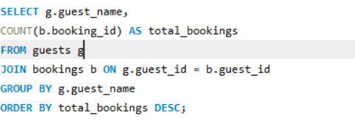
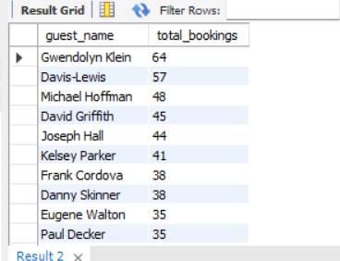
Which guests have made the highest number of bookings?
Key insights:
This query identifies the guests who have made the highest number of bookings and ranks them from most to least booked. It helps understand the most frequent customers of the hotel.

Slide 12
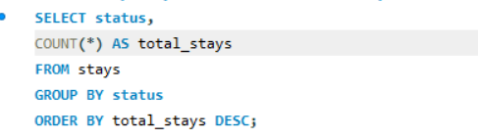
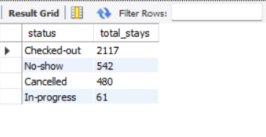
How many stays are there for each stay status?
Key Insights:
This query shows the number of stays for each status and ranks them from highest to lowest. It helps understand the most common stay statuses in the hotel.

Slide 13
Overall Key Findings
Booking demand: The analysis helps identify the hotels, booking channels, and room types with higher booking activity.
Guest behaviour: The analysis shows differences in guest booking frequency, spending, hotel activity, and behaviour between Individual and Corporate guests.
Stay performance: Stay outcomes, duration, and different statuses such as Checked-out, No-show, Cancelled, and In-progress can be compared to understand overall stay performance.
Staff & room utilization: The analysis helps identify staff workload, room usage, and differences in performance across staff members and rooms.
Booking & stay problems: Cancellations, no-shows, service requests, and hotels with higher problem levels can be identified for further improvement.

Slide 14
Business Recommendations
Optimize booking channels: Focus on the booking channels that generate higher booking activity and regularly monitor their performance.
Improve room availability: Maintain sufficient availability for room types that have higher demand and use booking trends for better room planning.
Understand guest behaviour: Use guest booking patterns and spending behaviour to improve customer engagement and provide more suitable services.
Improve hotel operations: Monitor stay outcomes, staff workload, and room usage to improve operational efficiency and resource utilization.
Reduce booking and stay problems: Closely monitor cancellations, no-shows, and high service requests, and take corrective actions to improve the overall guest experience.

Slide 15
Conclusion
This project demonstrates how hotel reservation data can be analyzed using MySQL and SQL to support business decision-making.
The analysis provides an understanding of booking demand, guest booking behaviour, stay performance, staff performance, and room utilization.
It also helps identify important operational issues such as cancellations, no-shows, and service requests.
By connecting the different tables and analyzing the data through SQL queries, we can convert raw reservation data into meaningful business insights.
Overall, the project shows how a structured, data-driven approach can help StayPoint Hospitality improve its operations, utilize resources effectively, and make better business decisions

Slide 16

THANK YOU

